Slide 1


Slide 2
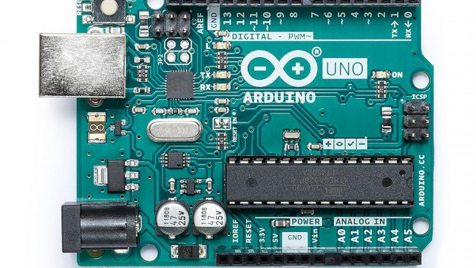
Ardunio Quick Start

Slide 3
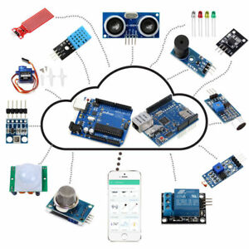
1) Arduino – it is a platform for developer our projects.
It is contains with hardware and software.

Slide 4
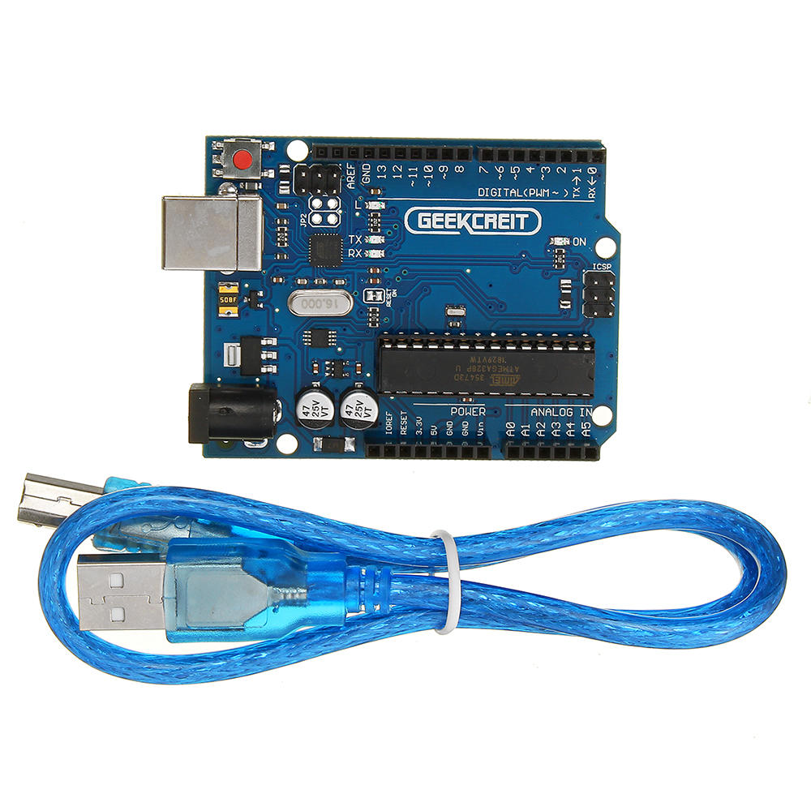
Arduino conected with usb cable for PC .

Slide 5
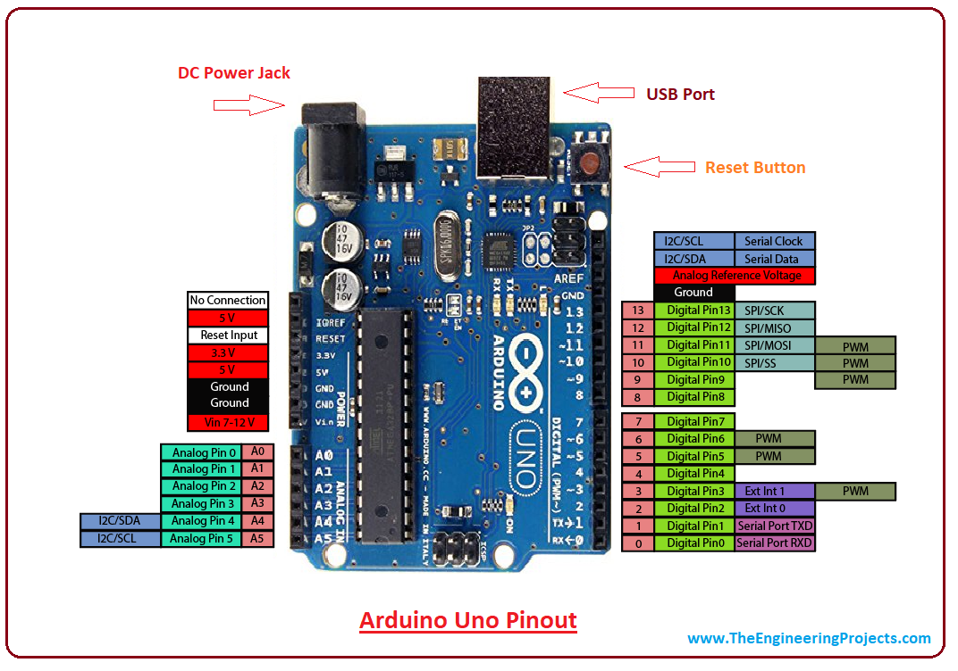
Arduino Ports
Arduino have analog and digital. Analog pin – can measure analog signal . It gaves signal from 0 – 1023 . Digital Pin – can measure only digital signal . And give only 0 or 1 . So and give only on input 0 or 5 V . So the digital pin can generate a PWM signal.

Slide 6
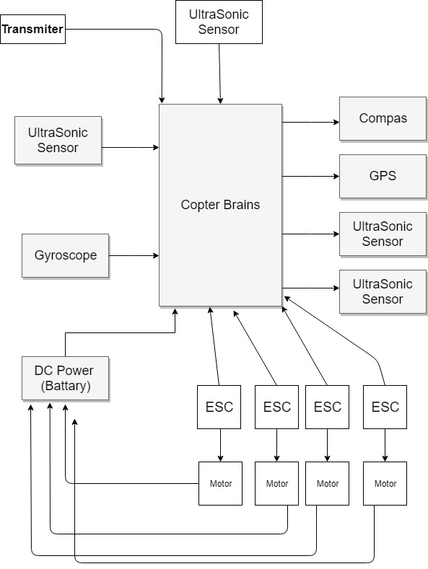
Our work.
So we have a big project – copter. So we be a create small tasks to acive it .

Slide 7
Coding
So firstly when you are coding open in yours broswers https://www.arduino.cc/reference/en/ here ar C language syntax.
If we need my help just ask it.

Slide 8
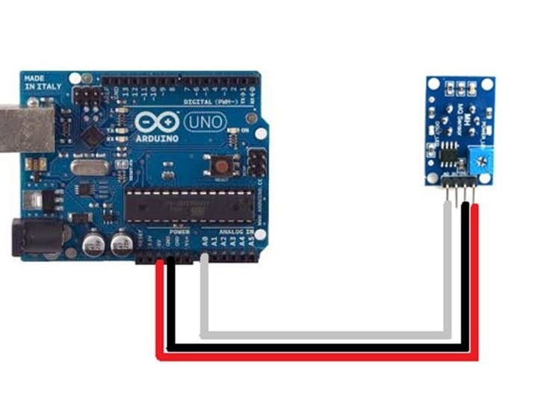
Any sensors need power ( GND and Vcc ) . Sensors can use another voltages . So look it in datasheet before use.

Slide 9
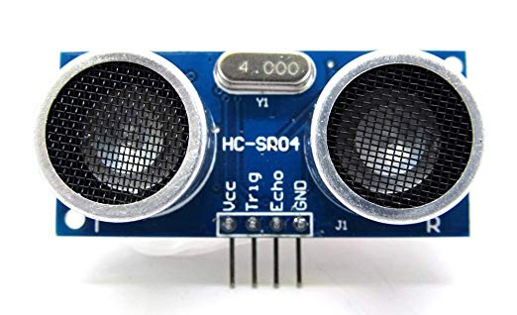
Today we will use ultrasonics sensor .

Slide 10
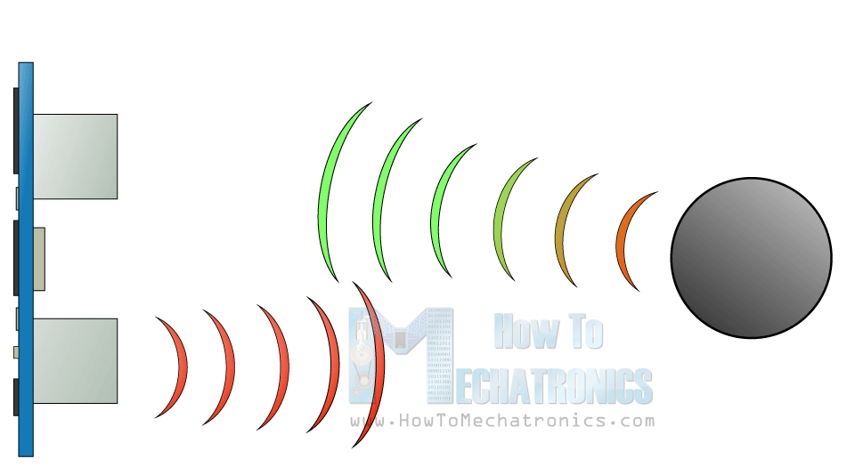
How works sensor

Slide 11
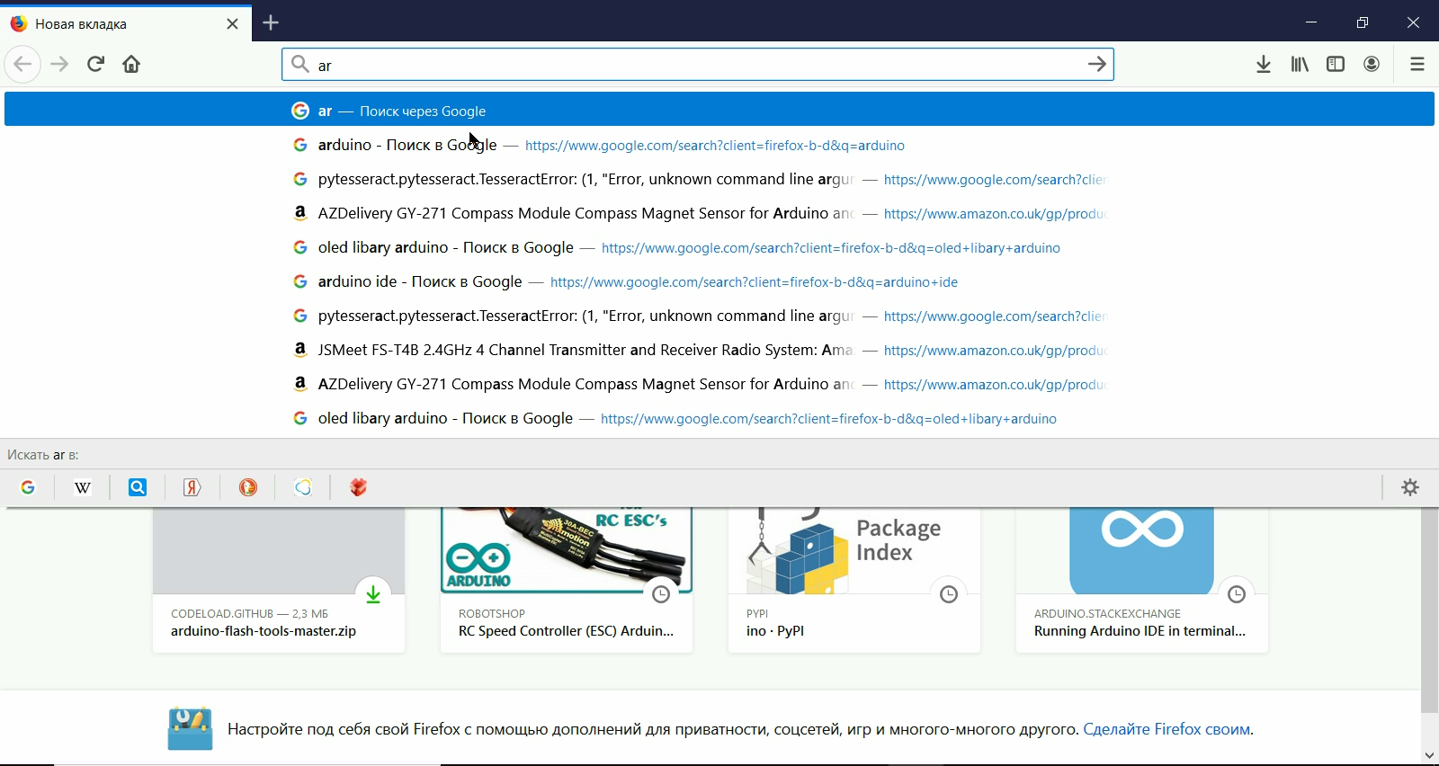

Slide 12
First task
Take a UltraSonic Sensor
Find info how connect and use it .
Find a libary
Write a code with shows distance in Serial Monitor
Show it to me.

Slide 13
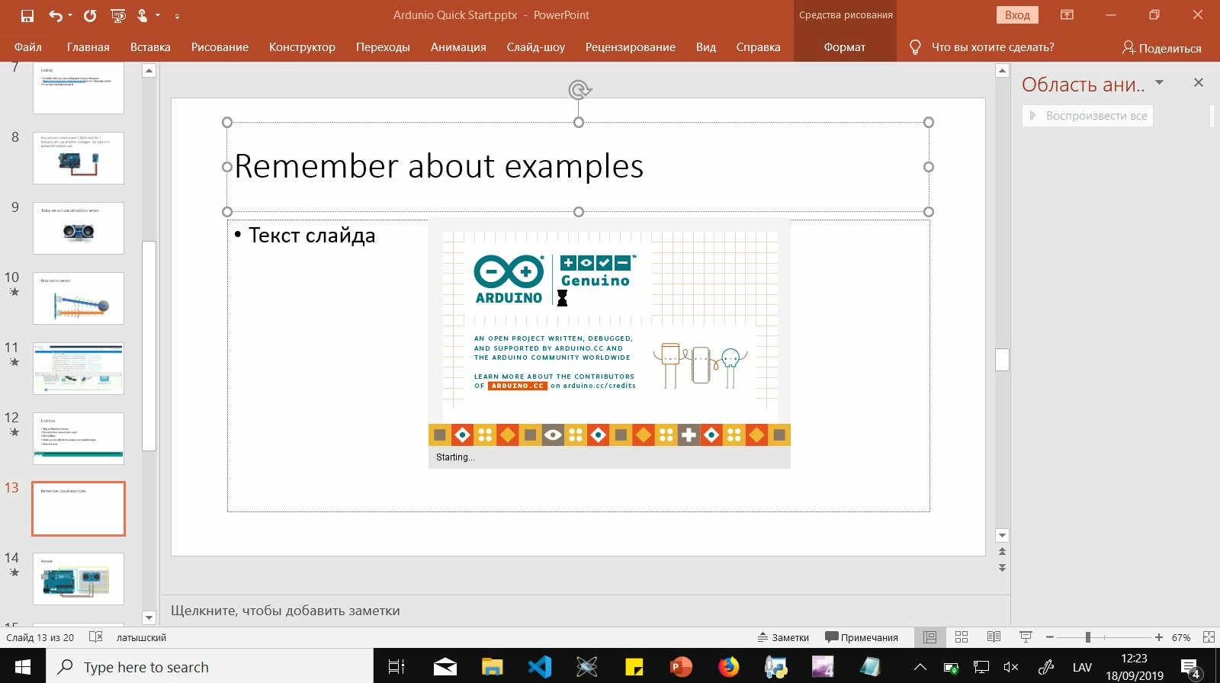
Remember about examples

Slide 14
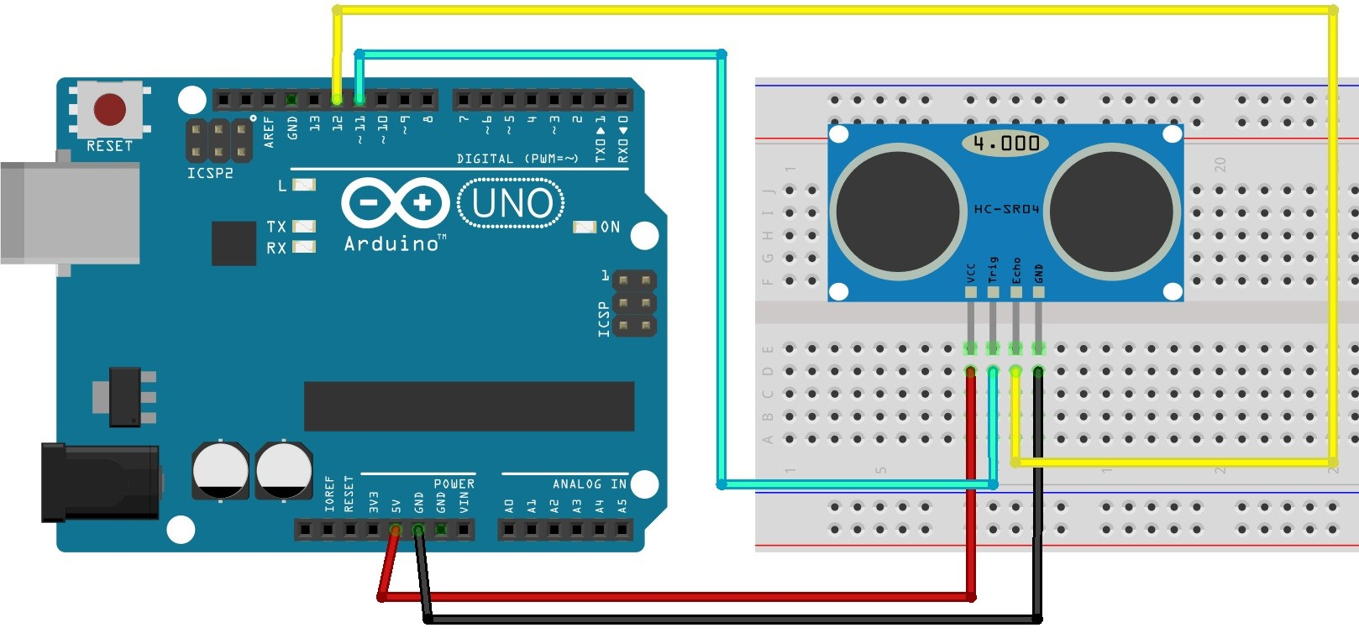
Answer

Slide 15

Answer in code

Slide 16
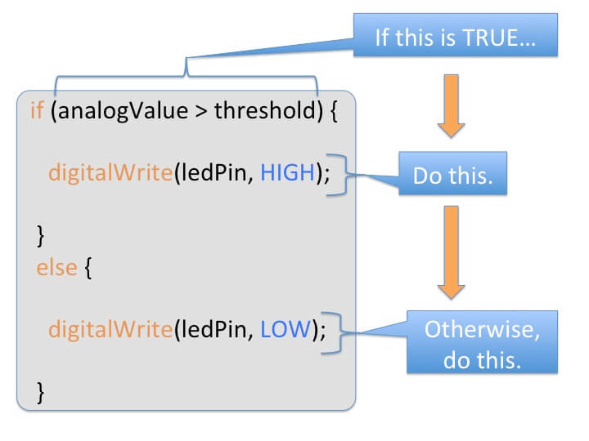

Slide 17
Answer in code

Slide 18
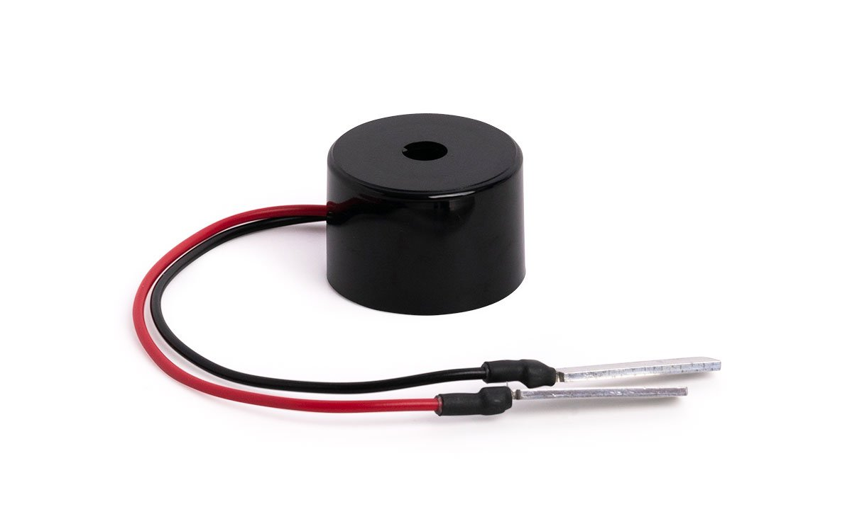
How we will do a
Take a buzzer ! After it connect it to arduino . And write code for if distance is closer than 5 cm it will generate sound ( Use a vairble)

Slide 19
Answer in code

Slide 20
Using the led if all okay
1) Find in internet how connect a led for arduino.
2) Do it
3) Edit code for if distane is biger than 5 cm led in off if not led is on
4) Buzzer still works.

Slide 22
Thank You ! See you next Wednesday!

